Slide 1
Detection of size of the body part using Image Processing

Slide 2
Mentor
Group Members
Shivarama Devarasetty
Akash Katragadda
Piyush Jindal
Ankur Kumar Singh
Lavannya Chavan
Mr.Vikas Upadhyaya

Slide 3
Rationale of the Project
Determination of the size of the Foot.
Determination of the size of the Foot irrespective of the camera angle.
Removal for the necessity of Manual measurement.
Provision for online shopping.

Slide 4
Objectives
Segmentation of the image and analyzing the size.
Efficient strategy to reduce the approximation Error
Differentiation between the appropriate object/body part and redundant object in the image basing on the position of reference object.
Image enhancement: removing noise and sharpening of image.

Slide 5
Global Thresholding using Otsu’s Method
Otsu’s basically considers different intensity levels present in an image.
At, first it choses a threshold value(‘T’), such that it divides the whole image into two sets based on pixel intensities.
And it calculates the variance between these two classes for all possible ‘T’ values.
And that value of ‘T’ is considered for which the between class variance is maximum.

Slide 6
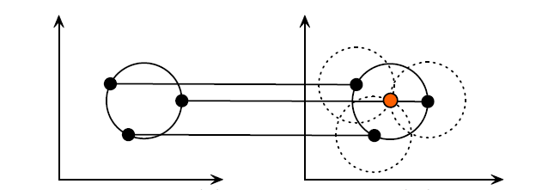
Circular Hough Transform
First, we find all possible edges in the image using any of the edge detection technique.
Taking each and every edge point as
a center, all circles of desired radii
range are generated .
The point where maximum number of
circles pass is considered to be the
actual center of the circle.

Slide 7
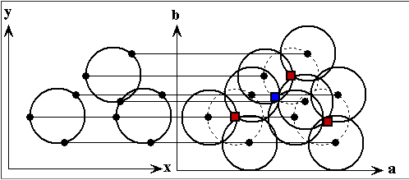

Slide 8
Methodology
A
Image Retrieval
Processing the Image using Otsu’s method
C
Detecting the reference object and foot
B
D
Calculating the length of the ref. object
E
Finding the length of the Foot(pixels).
F
Estimation of the size of the Foot basing on the size of the ref. object.

Slide 9
DEMONSTRATION

Slide 10
Algorithm and results:
Initially acquired Image(Lighter background)
Presence of the reference Object.
Presence of a redundant Object.

Slide 11
Segmentation of the Image
Segmentation of the image using Otsu’s Method.

Slide 12
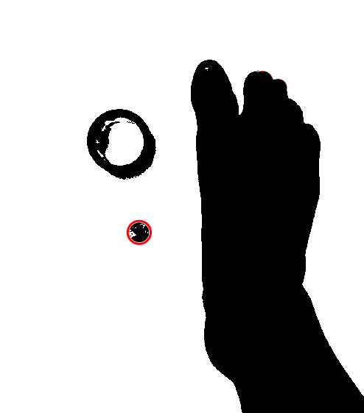
Detection of reference object
Detection of reference object using Circular Hough Transform.
Differentiation between reference object and redundant object.
Calculate the size of reference object (in pixels).

Slide 13
Determination of Length of the Foot
Detect Foot Start and end.
After determining the length of foot in pixels.
Length of foot(in cm) = pix_size(cm)*Length(in pixels)
Convert length to size using size table.

Slide 14
Handling darker background
Initially acquired Image(Darker background)
Presence of the reference Object.
Presence of a redundant Object.

Slide 15
Segmentation of the Image
Segmentation of the image using Otsu’s Method.
Algorithm Detects the darker background using the developed algorithm.
If background is darker ,we process it accoudingly.

Slide 16
Again, the reference object is detected in processed image.

Slide 17
Determination of Length of the Foot:
After determining the length of foot in pixels

Slide 18
Difficulties
Increase in Approximation Error with decrease in reference object size.
Differentiation between the reference object and other objects which are in the same radii range as reference object.

Slide 19
THANK YOU

